Slide 1
Women’s Empowerment Breakfast

Slide 2
Acknowledgment of Support
This program was made possible by an independent educational grant from Roche Diagnostics.

Slide 3
Presentation Outline
What is cervical cancer?
Risk factors for cervical
Cervical cancer rates
Cervical cancer disparities
What is HPV?
HPV and the link to cervical cancer
HPV transmission
HPV prevention
Cervical cancer prevention
HPV vaccination
Cervical cancer screening
Cervical cancer treatment options
Conclusion

Slide 4
What is Cervical Cancer?

Slide 5
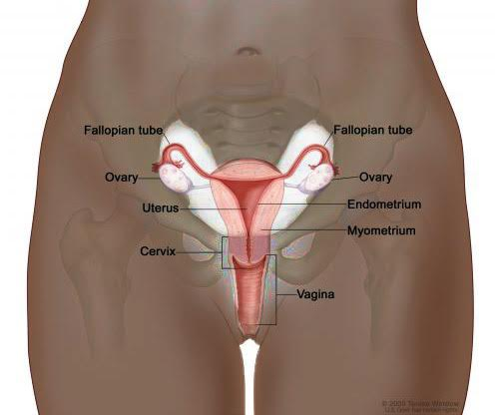
Cervical Cancer Background
What is it? Cervical cancer is cancer of the cervix, which is the opening from the vagina to the uterus.
Cervical cancer happens when there is an overgrowth of abnormal cells in the cervix.
What causes it? Over 99% of cervical cancers caused by HPV.
Who gets it? Women of all ages who have a cervix
Location of the Cervix
in the Body

Slide 6
Risk Factors for Cervical Cancer
Over 99% of cervical cancers caused by HPV.
Women must have persistent (long-lasting) HPV infection before they will develop cervical cancer.
Factors that increase risk for cervical cancer:
Never/Rarely Being Screened
History of sexually transmitted infections (STIs)
HIV and other immune-compromised conditions
Smoking
Smokers with HPV are 2-3 X more likely to develop cancer

Slide 7
Cervical Cancer Cases
12,820 cases in US
4,200 deaths in US
528,000
Cases
worldwide
266,000 deaths worldwide
American Cancer Society. Cancer Facts and Figures. 2017; GLOBOCAN 2012 (IARC).
Notes:
Talking Points:
In the US in 2013, there were an estimated 12,820 cases of cervical cancer and 4,200 deaths [ACS 2017]
Worldwide:
528,000 cases per year from cervical cancer [IARC 2012]
266,000 deaths per year from cervical cancer [IARC 2012]
85% of deaths occur in developing countries [IARC 2012]

Slide 8
Health Disparities
Lifetime risk of developing cervical cancer
Non-Hispanic White: 1 in 176
Black: 1 in 130
Lifetime risk of dying from cervical cancer
Non-Hispanic White: 1 in 506
Black: 1 in 265
2016: estimated 2,290 cases of invasive cervical cancer among black women
2016: estimated 750 deaths of cervical cancer among black women
Black women remain twice as likely to die from cervical cancer as white women.
Black women are more likely to be diagnosed at a later stage of cancer than white women, and therefore they have lower survival rates.
Racial differences in stage at diagnosis may be due to differences in the quality of screening and follow-up after abnormal results.
American Cancer Society Facts and Figures 2016-2018
Notes:
American Cancer Society. Facts and Figures 2016-2018

Slide 9
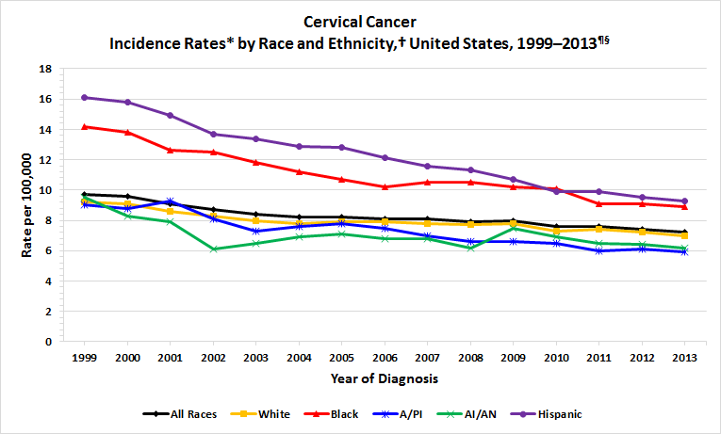
Incidence Rates by Race/Ethnicity
CDC’s National Program of Cancer Registries and National Cancer Institute’s Surveillance, Epidemiology, and End Results program, 2014

Slide 10
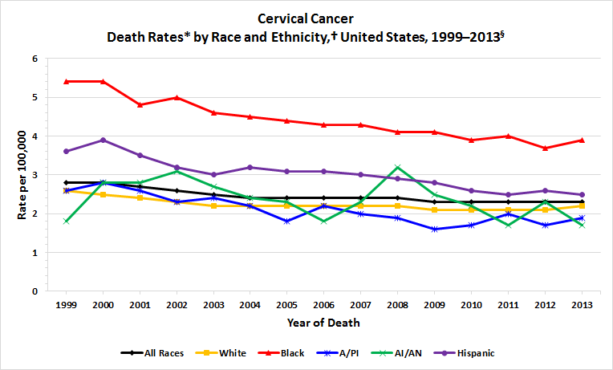
Mortality Rates by Race/Ethnicity
CDC’s National Program of Cancer Registries and National Cancer Institute’s Surveillance, Epidemiology, and End Results program, 2014

Slide 11
What is HPV?

Slide 12
HPV Background
What is HPV? Human papilloma virus, spread through genital contact
Who gets it? Any sexually active person
What happens when you get it?
There are usually no symptoms and no health consequences.
If it does not go away on its own, HPV can lead to cervical cell abnormalities and cervical cancer.

Slide 13
Human Papillomavirus Background
HPV DNA is found in virtually all (99.7%) cervical cancers.
There are over 100 types of HPV, of which about 15 are associated with cancer
Low-risk types - linked to genital warts
High-risk types - linked to cervical cancer
The two most common high risk types are HPV 16 and HPV 18. Together, they account for 70% of all cervical cancers.
The HPV types that cause warts do not cause cervical cancer.
Notes:
HPV is trophic for epithelium. The HPV types that infect hands or feet are not the same that infect the genitals. There are about 30 types that infect the ano-genital region. Low risk types of which there are about 10 –15 are linked to genital warts. High risk types are linked to cervical cancer and there are about 13 of these types.

Slide 14
HPV-associated Cancers
Cervical cancer
Anal cancer
Vulvar and vaginal cancer
Cancers of the oral cavity, pharynx, larynx
Notes:
Talking Points
HPV has been associated with a number of human cancers.
The virus is causative in cervical, anal, and vulvar/vaginal cancers and a co-factor in other cancers.
HPV is also causative for external genital warts.
References:
Munoz N, Castellsague X, de Gonzalez AB, Gissmann L. HPV in the etiology of human cancer. Vaccine. 2006;24(Suppl 3):S3/1-10.
Lacey CJN, Lowndes CM, Shah KV. Burden and management of non-cancerous HPV-related conditions: HPV-6/11 disease. Vaccine. 2006;24(Suppl 3):S3/35-41.

Slide 15
HPV in the United States
CDC estimates HPV is the most common sexually transmitted infection.
8 out of 10 women get HPV by age 50.
HPV takes about 10 to 15 years before cells become abnormal and then develop into cancer.
Notes:
CDC estimates that HPV is the most common STI. With 20 million infected in the US. And about 6 million new cases per year.

Slide 16
HPV and Cervical Cancer
All Women
Munoz N, Bosch FX, de Sanjose S, et al. N Engl J Med 2003;348:518-27.
Notes:
16
Here’s a great visual way of showing how common HPV is and how only a percentage get cervical cancer.

Slide 17
HPV and Cervical Cancer
All Women
Women with HPV infection
Munoz N, Bosch FX, de Sanjose S, et al. N Engl J Med 2003;348:518-27.
Notes:
17
Almost all women have HPV infection at some point in their lives.

Slide 18
HPV and Cervical Cancer
All Women
Women with HPV infection
Women with abnormal cervical cells
Munoz N, Bosch FX, de Sanjose S, et al. N Engl J Med 2003;348:518-27.
Notes:
18
Some women will have abnormal cell changes if they have HPV. Many of these cell changes will resolve on their own and won’t need to be treated.

Slide 19
HPV and Cervical Cancer
All Women
Women with HPV infection
Women with abnormal cervical cells
Women with CIN II and CIN III
Munoz N, Bosch FX, de Sanjose S, et al. N Engl J Med 2003;348:518-27.
Notes:
19
A portion of women with abnormal cells will have high-grade cervical disease, meaning cell changes that need to be treated before they develop into cancer.

Slide 20
HPV and Cervical Cancer
All Women
Women with HPV infection
Women with abnormal cervical cells
Women with CIN II and CIN III
Women with cervical cancer
Munoz N, Bosch FX, de Sanjose S, et al. N Engl J Med 2003;348:518-27.
Notes:
20
And then, some women will end up with cervical cancer.

Slide 21
HPV Transmission
Skin-to-skin contact in the genital region
Vaginal sex
Oral sex
Anal sex
Non-penetrative activities where genitals are in contact
Contact with an infected surface
Sex toy
Notes:
Talking Points
Sexual intercourse is the primary route of HPV transmission.
HPV is transmitted via direct genital contact (rather than via body fluids, like most STIs). [Burchell 2006]
Receptive anal intercourse is strongly associated with HPV infection. [Burchell 2006]
Genital contact in the absence of intercourse is a plausible means for HPV transmission, but the risk associated with this contact is much lower than that for intercourse. [Burchell 2006; CDC HPV Information for Clinicians]
The virus also can be transmitted via oral-genital contact. [Burchell 2006; Hernandez 2008]
HPV is not thought to survive for long on inanimate objects; however, it is possible that transmission could occur through objects shared in the short term, such as insertive sex toys. [Trottier 2006]
References:
Centers for Disease Control and Prevention. Human Papillomavirus: HPV Information for Clinicians. November 2006. Available at: http://www.cdc.gov/std/HPV/hpv-clinicians-brochure.htm. Accessed March 20, 2007.
Burchell AN, Winer RL, de Sanjose S, Franco EL. Epidemiology and transmission dynamics of genital HPV infection. Vaccine. 2006;24(Suppl 3):S3/52-62.
Hernandez BY, Wilkens LR, Zhu X, Thompson P, McDuffie K, Shvetsov YB. Transmission of human papillomavirus in heterosexual couples. Emerg Infect Dis. 2008;14:888-92.
Trottier H, Franco EL. Human papillomavirus and cervical cancer: Burden of illness and basis for prevention. Am J Manag Care. 2006;12:S462-72.

Slide 22
HPV: Partner Issues
HPV can be transmitted between partners.
Women who have sex with women and men who have sex with men are also at risk of HPV
Male HPV Infection
Often does not cause symptoms
Rarely linked to cancer of the penis and anus
No FDA approved HPV test for men

Slide 23
Important Facts about HPV
Most women will have HPV at some point.
There is no way of knowing how long HPV has been present
Having HPV is not a sign of infidelity or promiscuity
Most women will clear an HPV infection within 2 years
Long-lasting HPV infection can cause cervical cancer
Most women with HPV do not get cancer
Monk BJ. Cancer. 2004; Moscicki AB. JAMA. 2001.
Notes:
Talking Points:
This slide shows educational messages about HPV.
HPV is a virus that is sexually transmitted and very common.
HPV infection usually clears without treatment.
Persistent infection with HPV can cause cervical cancer.
Most women with HPV will not get cervical cancer.
References:
Monk BJ, Wiley DJ. Human papillomavirus infections: truth or consequences. Cancer. 2004;100:225-7.
Moscicki AB, Hills N, Shiboski S, Powell K, Jay N, Hanson E, et al. Risks for incident human papillomavirus infection and low-grade squamous intraepithelial lesion development in young females. JAMA. 2001;285:2995-3002.
---
Original content for this slide submitted by xxx

Slide 24
Prevention of HPV Infection
Abstain from sexual contact
Have sex with one partner who has had no other partners
Even if you have had only one partner, you still could be infected with HPV.
Limit number of partners
Use condoms
Although condoms prevent partial protection from HPV, they do not offer complete protection since they do not cover all of the skin in the genital area.
Get the HPV vaccine

Slide 25
Preventing Cervical Cancer

Slide 26
The HPV Vaccine
HPV vaccines are designed to prevent the HPV types that cause most cervical cancers, including HPV 16 and 18.
Gardasil, the most commonly offered HPV
vaccine, also protects against genital warts.
HPV vaccines are very effective. They provide nearly 100% protection against cervical precancer and genital warts.
The vaccination series can be started as young as 9 years of age. It is approved for people ages 9 to 26.
Notes:
26

Slide 27
Safety of HPV Vaccine
The vaccine went through rigorous testing, with a combined 44,000 females and males tested with in Gardasil trials.
More than 90 million doses of HPV vaccine were given in the U.S. from June 2006 through March 2016 and many more worldwide
No vaccine is without risk. But the risks are similar to other vaccines and are small.
The Centers for Disease Control (CDC) continuously monitors vaccine-related adverse events
Notes:
27

Slide 28
Side Effects of HPV Vaccine
The most common reported side effects are usually mild and go away on their own:
Redness, soreness or swelling in the arm where the shot is given.
Fever
Headaches (like when you have a cold or fever).
Feeling tired
Muscle or joint pain
Fainting. To prevent fainting, people should sit or lie down when getting the vaccine and for 15 minutes after the shot.
Notes:
28

Slide 29
HPV Vaccination
HPV vaccine is recommended for:
Girls and boys ages 11 to 12 (can be started as early as age 9)
Girls and young women ages 13 to 26 who have not received vaccine
Boys and young men ages 13 to 21 who have not received vaccine
Gay, bisexual, men who have sex with men, and immunocompromised people who have not been vaccinated previously

Slide 30
Age recommendations for Vaccine
Girls and boys should receive the HPV vaccine before they come in contact with HPV – before they are sexually active, even if that means skin to skin contact in the genital region
The immune system responds better to the vaccine in younger children
Clinical trials showed limited or no protection against HPV-related diseases in women 26 and older
Girls and women who have been vaccinated should still be screened, starting at age 21

Slide 31
HPV Vaccination Dosing Schedule
For children starting the vaccination series before their 15th birthday:
Two doses: 2nd dose given 6 to 12 months after the first dose
For teens and young adults starting the series after age 15:
Three doses: at month 0, 1-2 and 6 months

Slide 32
Cervical Cancer Screening Methods
Pap test: Looks for cell changes in the cervix
HPV test: Looks for the HPV virus that causes these cell changes
How are the tests done?
During a pelvic exam, a speculum is used to open up the cervix.
A swab is moved around the cervix to collect cells.
The cells are put into a vial filled with liquid.
The vial is sent out to the lab where a Pap test and/or an HPV test can be done from the same sample.

Slide 33
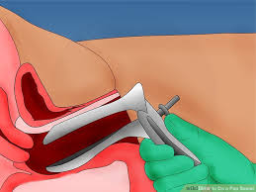
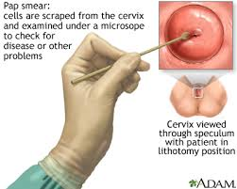
Cervical Cancer Screening Methods
Side view with speculum
Swab being used to collect cells from the cervix

Slide 34
Cervical Cancer Screening Guidelines
American College of Obstetricians and Gynecologists (ACOG)
American Cancer Society (ACS)
American Society of Colopscopy and Cervical Pathology (ASCCP)
United States Preventative Task Force (USPSTF)

Slide 35
General Guidelines
Starting at age 21: Pap test every 3 years
Starting at age 30:
Pap and HPV test together every 5 years (preferred)
Pap test every 3 years
Another option is HPV test starting at age 25, followed by additional tests if necessary

Slide 36
Annual Screening for High-Risk Women
High-risk women who should be screened annually include those:
who are persistently high-risk HPV positive
who have a history of high-grade cervical disease and cancer
who are immuno-compromised (including HIV infection)
who had in-utero exposure to diethylstilbestrol (DES)

Slide 37
Significance of age 30
Very common to have HPV in your 20s.
Competent immune systems will fight off HPV.
HPV is much less common by age 30.
Immune system should combat HPV. If not, likely persistent infection.
Women older than 30 with HPV are at greater risk of developing cervical cancer and should be monitored more closely.

Slide 38
Changes in Guidelines
With a better understanding of HPV’s role in cervical cancer, guidelines have gone through major changes over the past 15 years.
They are still changing! New guidelines will be out in 2018.
We no longer get annual Pap tests.
We no longer start Pap tests before age 21, even if you had sex at a younger age.
We now have the option to do an HPV test first (to look for the virus), and follow up with other tests if you have the virus.
Bottom line: Get screened!

Slide 39
Screening Results
If you have HPV, don’t panic! Most HPV will go away on its own and not cause cervical cancer.
BUT, be sure to go to any follow-up visits. Your healthcare provider will monitor you regularly to be sure abnormal cells are not developing.
If you have an abnormal Pap, this means that you have abnormal cells on your cervix. But this does not mean you have cancer.
Follow-up tests include:
Colposcopy to view your cervix more closely
Biopsy to determine if you need treatment
Notes:
Low-grade disease (CIN) – cell changes are mild
High-grade disease (CIN II or CIN III) – cell changes are moderate to severe
CIN 1 usually goes away by itself
CIN II or CIN III usually need to be treated

Slide 40
Treatment Options

Slide 41
Treatment for Abnormal Cells
LEEP (loop electrosurgical excision procedure)
Laser or “cold-knife” conization (cone biopsy)
Laser therapy
Cryotherapy
Notes:
Low-grade disease (CIN) – cell changes are mild
High-grade disease (CIN II or CIN III) – cell changes are moderate to severe
CIN 1 usually goes away by itself
CIN II or CIN III usually need to be treated

Slide 42
Treatment for Cancer
Surgery
Removal of tumor
Hysterectomy – removal of uterus and cervix
Radical hysterectomy – removal of uterus, cervix, upper vagina, surrounding tissues and possibly the ovaries and fallopian tubes
Radical vaginal trachelotomy – removal of the cervix, upper vagina, and pelvic lymph nodes. This is an option for women who may want to become pregnant in the future and their cancer is in an early stage.
Notes:
Low-grade disease (CIN) – cell changes are mild
High-grade disease (CIN II or CIN III) – cell changes are moderate to severe
CIN 1 usually goes away by itself
CIN II or CIN III usually need to be treated

Slide 43
Treatment for Cancer, continued
Chemotherapy
Medication either injected into a vein or taken by mouth
Radiation therapy
High energy x-rays given externally or internally
Clinical trials
Research studies that offer new investigative treatments that may be best suited for a specific type or stage of cancer

Slide 44
Key Takeaways

Slide 45
Key Take Home Points
HPV is extremely common.
Most people with HPV do not get cervical cancer.
Having HPV is not a marker of anyone’s infidelity or behavior.
Virtually ALL cervical cancers are caused by HPV
Notes:
45

Slide 46
Key Take Home Points
HPV vaccines can protect children and young men and women from getting 90% of the types of HPV that cause cancer.
HPV vaccines are safe and very effective.
Routine screening with Pap tests and HPV tests (every 3 to 5 years) are essential to prevent cervical cancer.
Even women in long-term relationships or women who have not had sex in many years need to get screened.
It is extremely important to follow-up with your healthcare provider on your test results.
Notes:
46

Slide 47
Conclusion
Cervical cancer can be prevented with vaccination, screening and follow-up.
For girls and boys 11 to 12: Get the HPV vaccine
For women 21 to 29: Pap tests every 3 years
For women 30 and older: Pap + HPV test every 5 years
Another option for women 25 and older is to get the HPV test followed by other tests if necessary
Final message: Get screened and follow-up on your results. It could save your life!

Slide 48
Questions

